Slide 1
WireFrames
Innobyte Systems

Slide 2
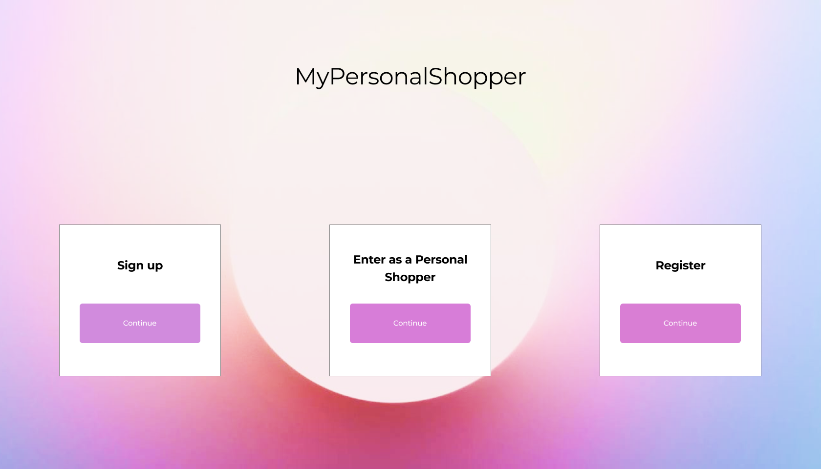
WireFrames
01
Primera Pantalla

Slide 3
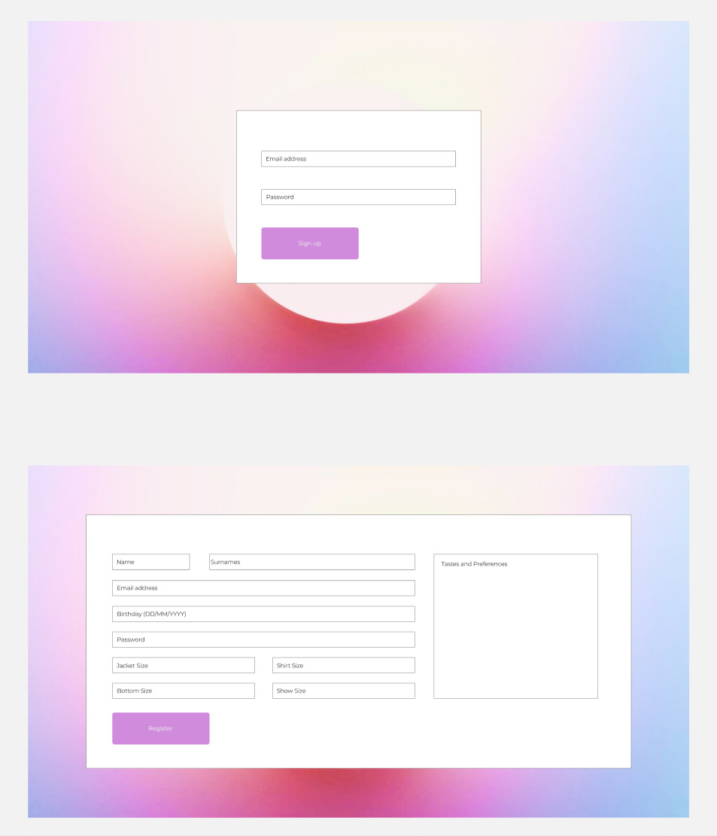
WireFrames
02
Sing In

Slide 4
WireFrames
03
Register

Slide 5


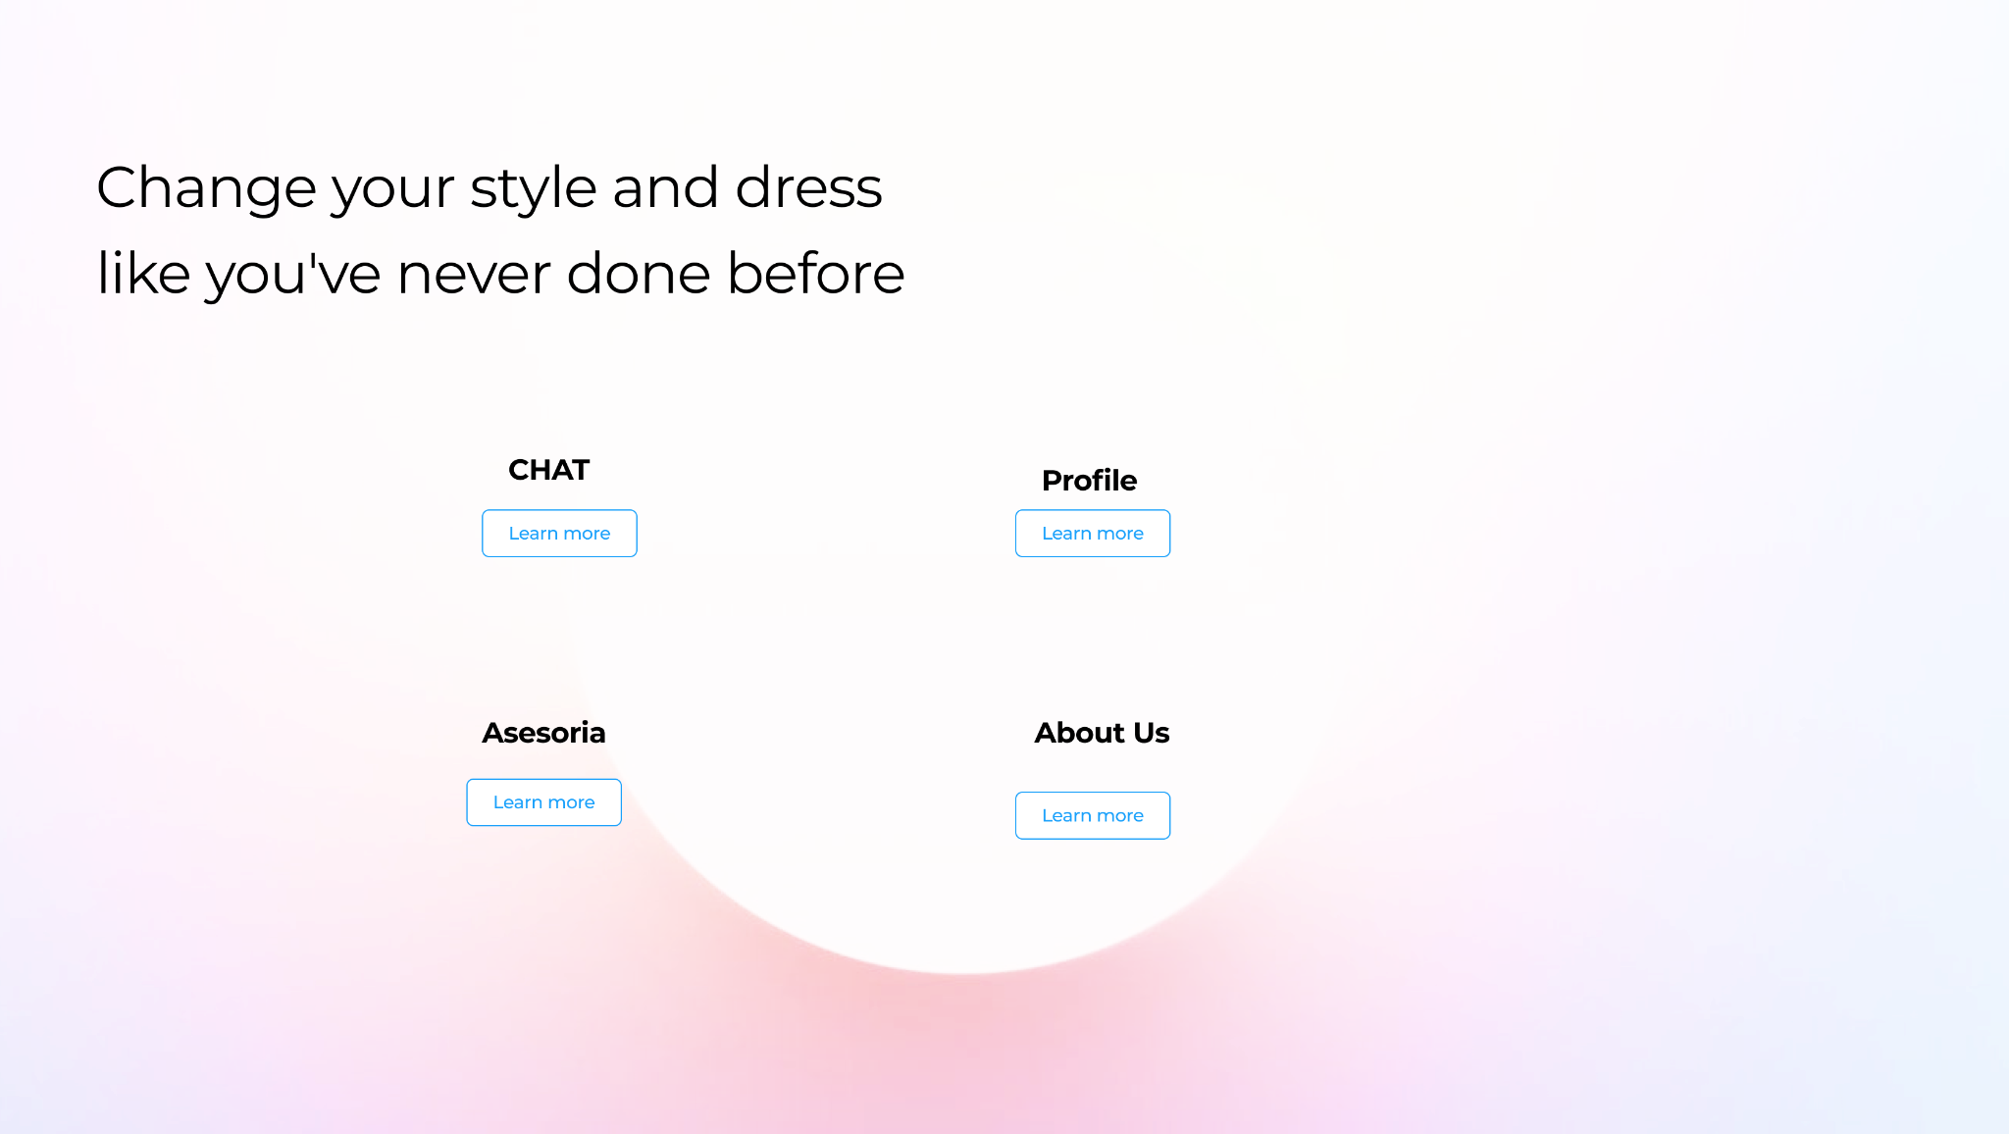
WireFrames
04
Homepage
User

Slide 6

WireFrames
04
Homepage
Personal Shopper

Slide 7

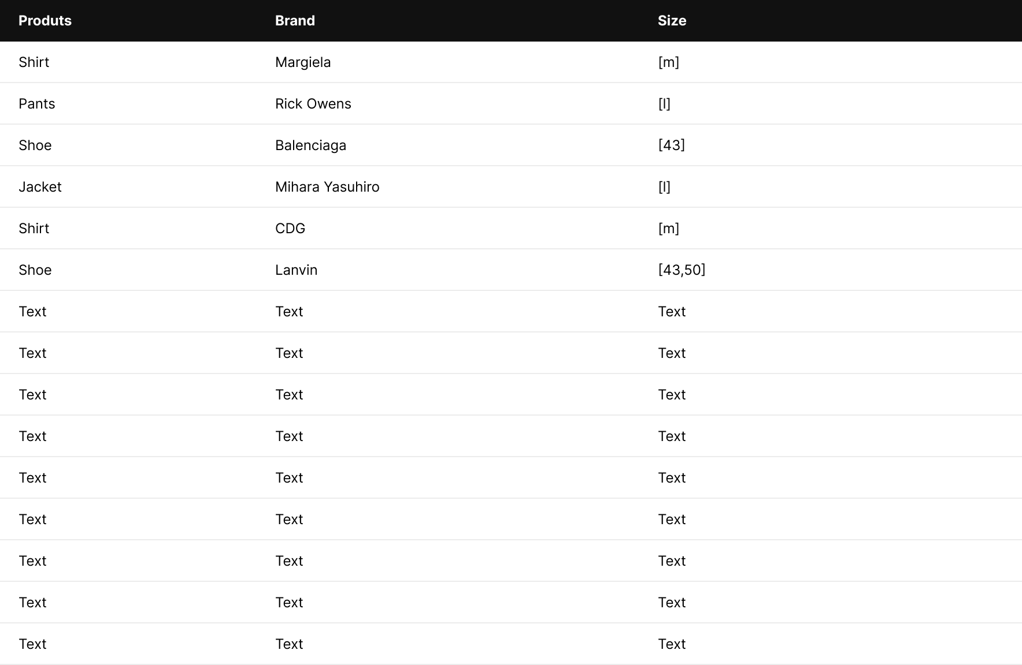
WireFrames
05
Asesoria

Slide 8
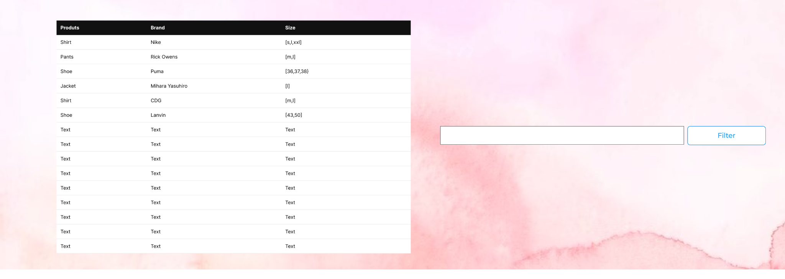
WireFrames
06
Stock

Slide 9
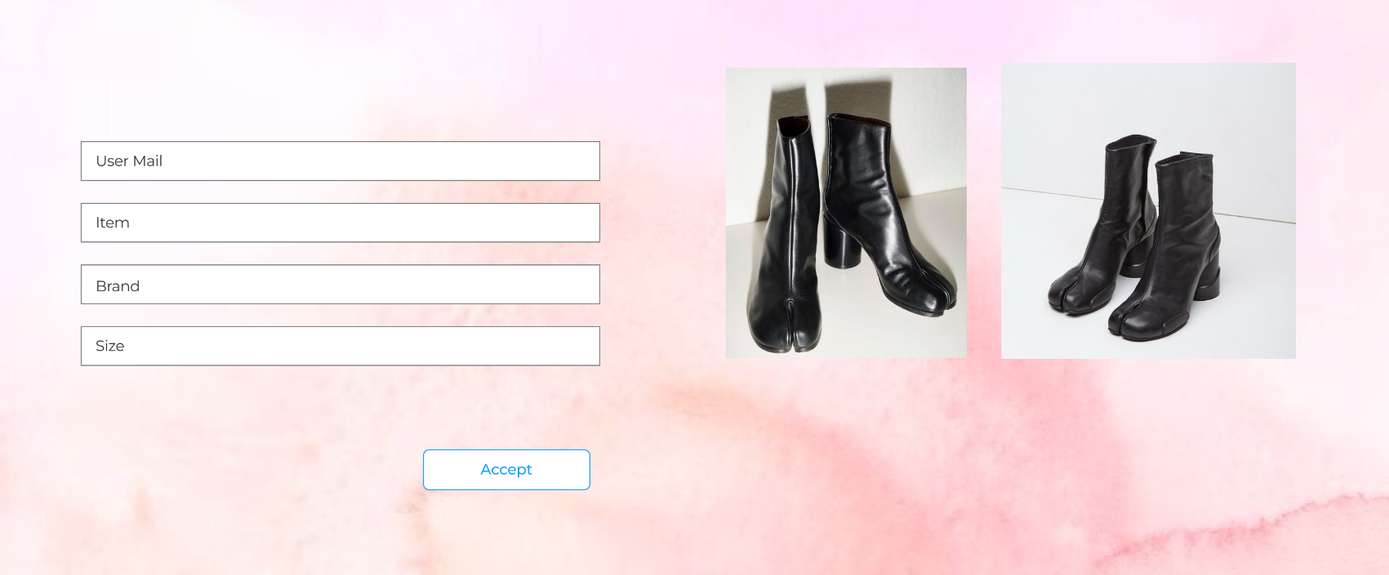
WireFrames
07
Select Products

